Slide 1


Greg Sasso
04/14/2023

Slide 2

Outline
Executive Summary
Introduction
Methodology
Results
Conclusion
Appendix

Slide 3
Executive Summary
Methods!
Collected data on Spacex launches by accessing the Spacex api and scraping the Falcon 9 Wikipedia page
Classified landing outcomes as successful or not successful
Perform exploratory data analysis using visualization and SQL
Create interactive visual analytics using Folium and Plotly Dash
Perform predictive analysis using classification models
Results!
Launches have gotten more successful over time
Launch sites are all close to the coast
ES-L1, GEO, and SSO are the most successful Orbit types
Classification models generally predict which launches will land successfully

Slide 4
Introduction
Spacex has been launching rockets for almost 15 years. Understanding it’s successes and failures is crucial improving consumer space travel.
This projects seeks to answer several questions:
What makes a rocket launch successful?
Where are successful launches located?
What tools can we use to make sure more launches are successful in the future?

Slide 5

Section 1

Slide 6
Methodology
Executive Summary
Data collection methodology:
Collected data on Spacex launches by accessing the Spacex ap and scraping the Falcon 9 Wikipedia page
Perform data wrangling
Classified landing outcomes as successful or not successful
Perform exploratory data analysis (EDA) using visualization and SQL
Perform interactive visual analytics using Folium and Plotly Dash
Perform predictive analysis using classification models
Used Scikit-learn to choose optimal classification models

Slide 7
Data Collection
I worked with two data sets
Data collected from the Spacex API.
Accessed multiple CSVs and merged them together to create the core Spacex data frame
Data from the Falcon 9 Wikipedia page
Used beautiful soup to scrape Falcon 9 data from tables on the Wikipedia page.

Slide 8
Data Collection – SpaceX API
Create functions to get specific data
Call data from Spacex URL
Transform called data to Dataframe
Separate out date specific to Falcon 9
Fix missing data by using average values
Code: https://github.com/gregsasso/Final-Project/blob/main/Data%20Collection.ipynb
Create Functions
Fix missing data
Get Data from API
Filter and Subset DF
Create Dataframe

Slide 9
Data Collection - Scraping
Define functions to get specific data from the Wikipedia page table
Request Wikipedia url
Use BeautifulSoup to read information from Wikipedia page
Create column headers from Wikipedia table headers
Extract data from Table on Falcon 9 launches to create data frame
Code: https://github.com/gregsasso/Final-Project/blob/main/Web%20Scraping.ipynb
Create Functions
Get data from Wikipedia table and create DF
Request Wikipedia URL
Find column headers
Get info from Wikipedia with Soup

Slide 10
Data Wrangling
Import data from csv
Check number of launches by site
Check number of each type of orbit
Check outcomes by orbit
Classify outcomes as either good or bad
Code: https://github.com/gregsasso/Final-Project/blob/main/Data%20Wrangling.ipynb
Import Data
Outcome Classification
Number of Launches
Outcomes by orbit
Number and types of orbit

Slide 11
EDA with Data Visualization
Used seaborn scatter plots to visualize multiple two variable relationships grouped by success type (Flight number vs launch site, Payload vs launch site, Payload vs Orbit type)
These allows us to quickly see if there are any relationships between the two variables
Used a bar chart to see the success types of various orbits
Bar chart allow us to compare multiple categories of a single variable quickly
Used a line chart to track success rates over time.
Line chart is ideal for check time trends
Code: https://github.com/gregsasso/Final-Project/blob/main/jupyter-labs-eda-dataviz.ipynb

Slide 12
EDA with SQL
SQL queries used for exploratory analysis:
Queried the distinct launch site names
Displayed 5 launches where the launch site began with CCA
Found the combined payload for all launches
Found the average payload for Falcon 9 V1.1
Found the date of the first successful landing
Displayed boosters with moderate payloads that had successful drone landings
Calculated total number of success and failures
Found boosters that carried the highest payload
Found the failed landings in 2015
Made a list in ascending order of all landing outcomes
Code: https://github.com/gregsasso/Final-Project/blob/main/SQL.ipynb

Slide 13
Build an Interactive Map with Folium
Added markers for all launch sites
Added circles to all launch sites to indicate number of lunches per site
Further added market clusters to indicate successful and unsuccessful launches per site
Added lines to important nearby infrastructure such as highways, cities, train lines, and the coast
Added all these objects help visualize important determinants of location and which locations had more successful launches
Code: https://github.com/gregsasso/Final-Project/blob/main/lab_jupyter_launch_site_location.ipynb

Slide 14
Build a Dashboard with Plotly Dash
Created interactive piecharts to show successful launches broken down by launch site. If a specific launch site is selected, the pie chart shows the breakdown of successes vs failures
This chart allows sites to be compared by success rate at a quick glance
Created an interactive scatter plot showing the breakdown of successful launches by payload and launch site.
This chart allows quick comparison about which payloads are most successful and a quick comparison between which sites launch which payloads.
Code: https://github.com/gregsasso/Final-Project/blob/main/spacex_dash_app.py

Slide 15
Predictive Analysis (Classification)
First step is to standardize the data and split the data in to training and test samples
Then the following steps to fit and score each model type (Logistic, SVM, Decision Tree, KNN):
Do a grid search to find optimal parameters
Estimate model
Find the score (predictive accuracy) of the model
Compare scores across models to find the optimal classification model.
Code: https://github.com/gregsasso/Final-Project/blob/main/SpaceX_Machine%20Learning%20Prediction_Part_5.ipynb
Standardized Data
Compare Scores
Create Train/Test Split
Score Model
Fit model

Slide 16
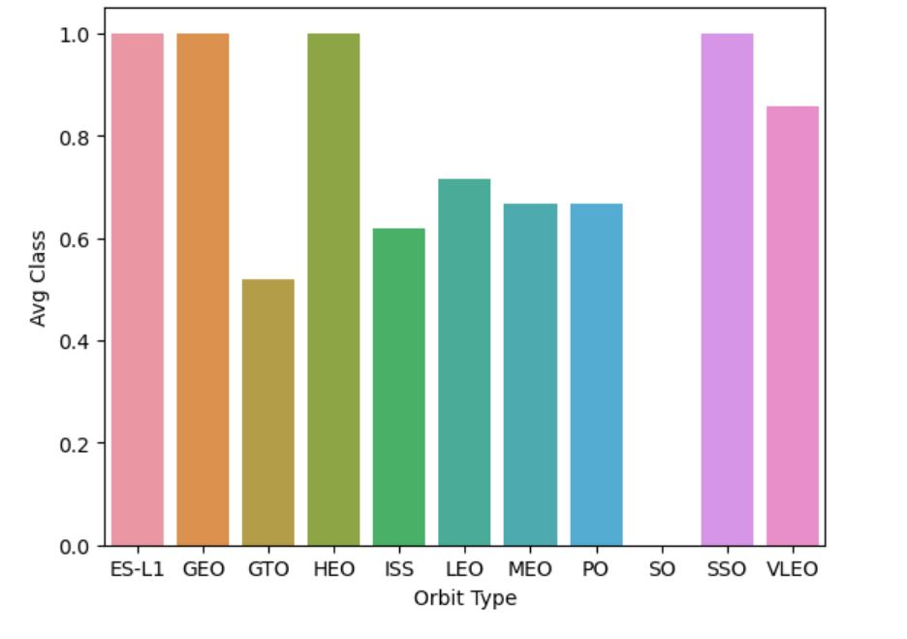
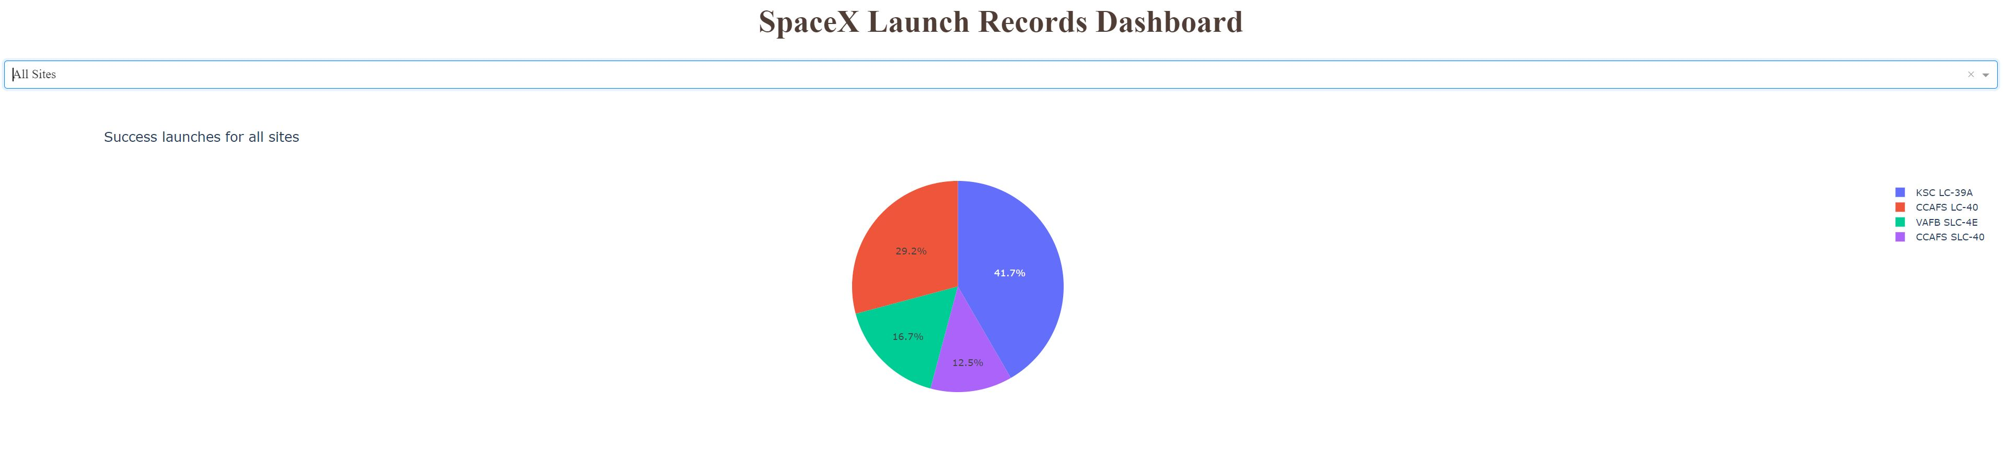
Results
Exploratory data shows correlations between different launch characteristics
Example of orbit type and launch success:
SQL queries used to find specific groupings such as all successful launches for medium payload boosters
Used interactive dashboard to summarize successes and payloads:
Used machine learning classification algorithms
to predict which launches would be successful and found KNN is the best algorithm for this task

Slide 17

Section 2

Slide 18
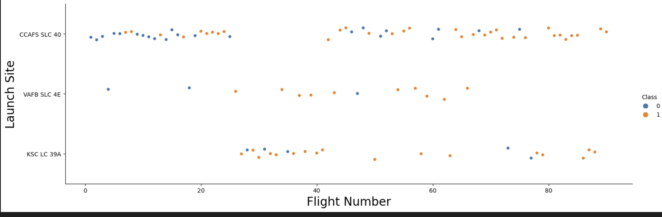
Flight Number vs. Launch Site
We can see that CCAFS has by far the most launches. KSC was used predominantly for launches between 23 and 41 and then a few after. VAFB has few launches.

Slide 19
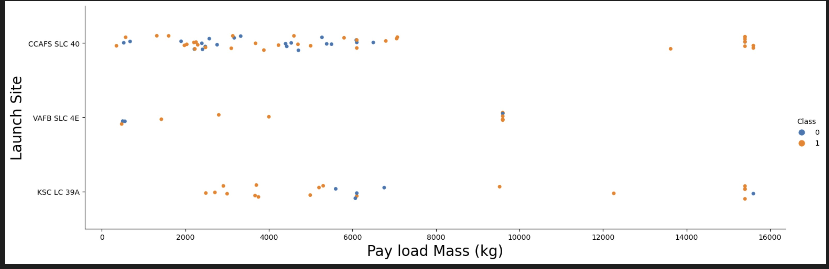
Payload vs. Launch Site
The VAFB site only handles low and moderate payloads. CCAFS has the greatest payload variety. Both CCAFS and KSC handle the heaviest payloads.

Slide 20
Success Rate vs. Orbit Type
This chart shows the success rate (“Class” on the y axis) by various Orbit types
ES-L1, GEO, and SSO are the most successful, having perfect success rates.
SO is the worst, having no successes.

Slide 21
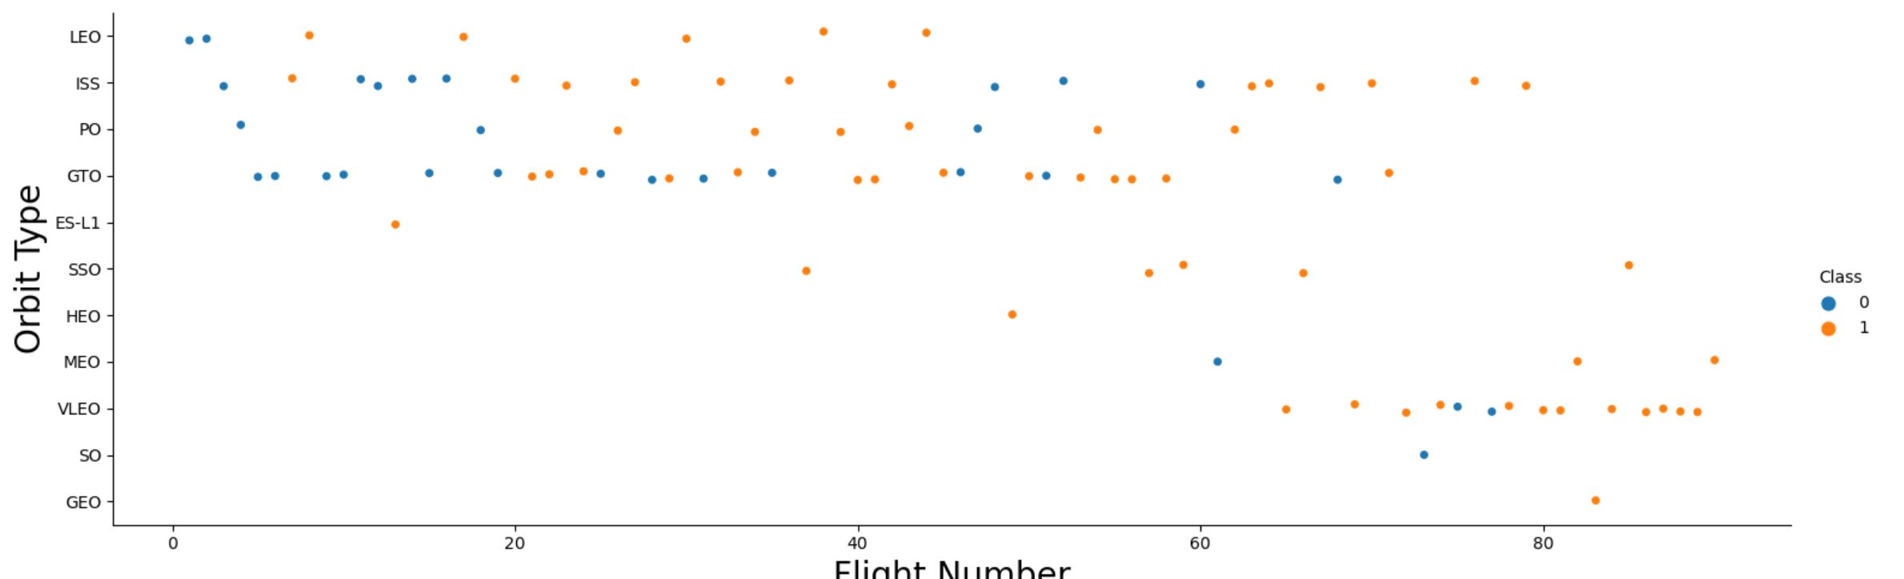
Flight Number vs. Orbit Type
The scatter plot shows flight number on the x axis and orbit type on the y axis.
Note that type of orbits has changed over time. LEO, ISS, PO, and GTO were common early. VLEO has be come much more common for later flights.

Slide 22
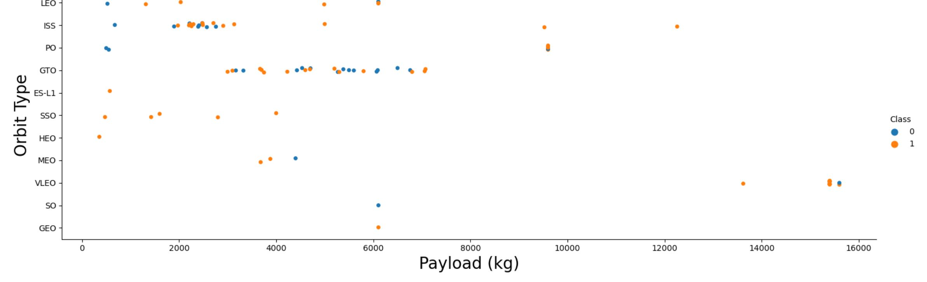
Payload vs. Orbit Type
With payload on the x axis and orbit type on the y axis, we can see that low payloads are concentrated with the ISS orbit type. Moderate payloads are concentrated in the GTO orbit type, and heavy payloads are concentrated in the VLEO orbit type.

Slide 23
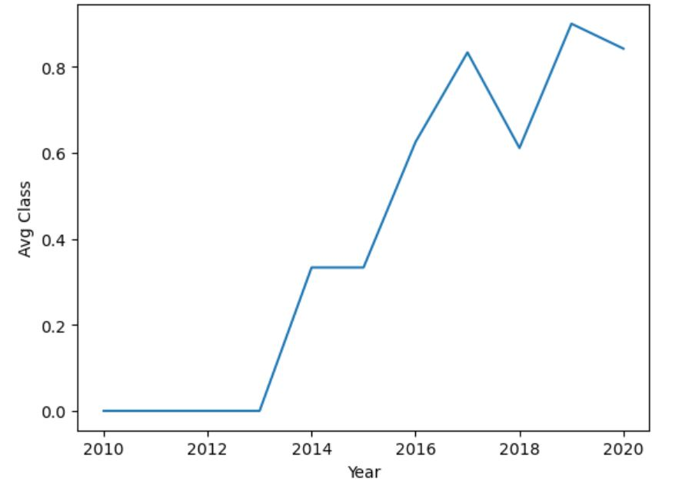
Launch Success Yearly Trend
There is a clear trend of more successful launches over time with 0 in 2010 and 80% in 2020.

Slide 24
All Launch Site Names
launch_site
CCAFS LC-40
CCAFS SLC-40
KSC LC-39A
VAFB SLC-4E
Using a sql query with the DISTINCT operator, we were able to find a list of all Spacex launch sites

Slide 25
Launch Site Names Begin with 'CCA'
2010-06-04 | 18:45:00 | F9 v1.0 B0003 | CCAFS LC-40 | Dragon Spacecraft Qualification Unit | 0 | LEO | SpaceX | Success | Failure (parachute)
2010-12-08 | 15:43:00 | F9 v1.0 B0004 | CCAFS LC-40 | Dragon demo flight C1, two CubeSats, barrel of Brouere cheese | 0 | LEO (ISS) | NASA (COTS) NRO | Success | Failure (parachute)
2012-05-22 | 7:44:00 | F9 v1.0 B0005 | CCAFS LC-40 | Dragon demo flight C2 | 525 | LEO (ISS) | NASA (COTS) | Success | No attempt
2012-10-08 | 0:35:00 | F9 v1.0 B0006 | CCAFS LC-40 | SpaceX CRS-1 | 500 | LEO (ISS) | NASA (CRS) | Success | No attempt
2013-03-01 | 15:10:00 | F9 v1.0 B0007 | CCAFS LC-40 | SpaceX CRS-2 | 677 | LEO (ISS) | NASA (CRS) | Success | No attempt
Looked for the first five records where launch site began with ‘CCA’, and copied all information for those records.

Slide 26
Total Payload Mass
The total Payload from all booster is 619967. To find this, I used the Sum function on the payload_mass_kg_ column.

Slide 27
Average Payload Mass by F9 v1.1
The average payload mass carried by booster version F9 v1.1 is
I used the AVG function on payload_mass_kg and WHERE Booster_version LIKE 'F9 v1.1%’ to only count booster F9 v1.1.
2534

Slide 28
First Successful Ground Landing Date
The first successful ground landing was 2010-06-04
I used the MIN function on DATE where mission_outcome LIKE 'Success’ to find the first successful landing.

Slide 29
Successful Drone Ship Landing with Payload between 4000 and 6000
payload
JCSAT-14
JCSAT-16
SES-10
SES-11 / EchoStar 105
I used a query to only select boosters WHERE landing_outcome LIKE 'Success (drone%' AND payload_mass_kg_ BETWEEN 4000 AND 6000. This limited the results to only the ones sought.

Slide 30
Total Number of Successful and Failure Mission Outcomes
mission_outcome | 2
Failure (in flight) | 1
Success | 99
Success (payload status unclear) | 1
I found the total number of successes and failures by using COUNT and grouping by mission_outcome.

Slide 31
Boosters Carried Maximum Payload
booster_version
F9 B5 B1048.4
F9 B5 B1049.4
F9 B5 B1051.3
F9 B5 B1056.4
F9 B5 B1048.5
F9 B5 B1051.4
F9 B5 B1049.5
F9 B5 B1060.2
F9 B5 B1058.3
F9 B5 B1051.6
F9 B5 B1060.3
F9 B5 B1049.7
Used a subquery to select only boosters where payload = MAX(payload_mass_kg_).

Slide 32
2015 Launch Records
2015-01-10 | Failure (drone ship) | F9 v1.1 B1012 | CCAFS LC-40
2015-04-14 | Failure (drone ship) | F9 v1.1 B1015 | CCAFS LC-40
Used a query to only select year 2015 and only recorders where landing_outcome had ‘Failure (drone ship)’

Slide 33
Rank Landing Outcomes Between 2010-06-04 and 2017-03-20
Selected the count of landing_outcomes and grouped by landing_outcome and then ordered them in ascending order.
1 | landing_outcome
1 | Precluded (drone ship)
2 | Failure (parachute)
2 | Uncontrolled (ocean)
3 | Failure
5 | Controlled (ocean)
5 | Failure (drone ship)
9 | Success (ground pad)
14 | Success (drone ship)
22 | No attempt
38 | Success

Slide 34

Section 3

Slide 35
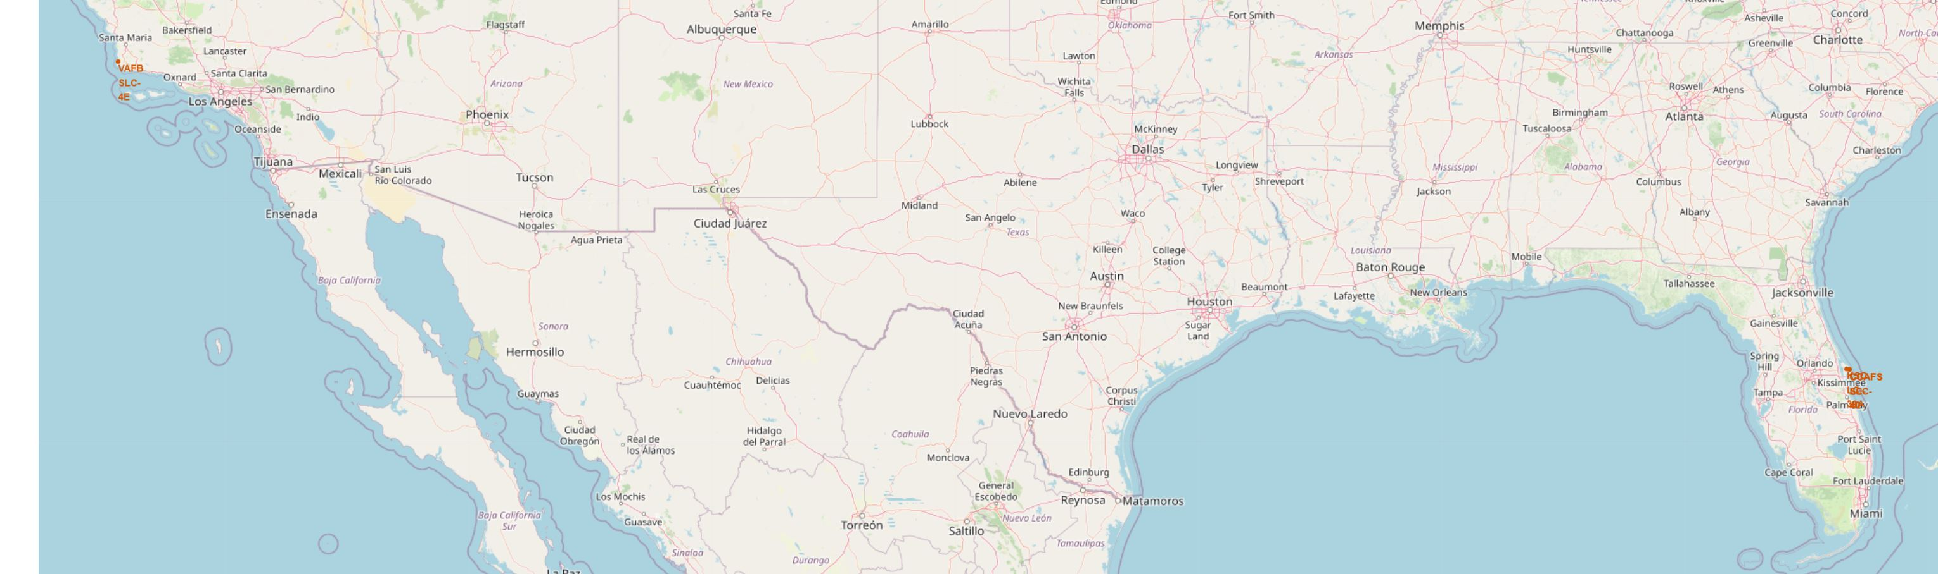
Map of Launch Sites
Here we can see that there is one launch site (VAFB SLC-4E) in California west of LA and the other three launch sites are on the east coast of Floriday.

Slide 36
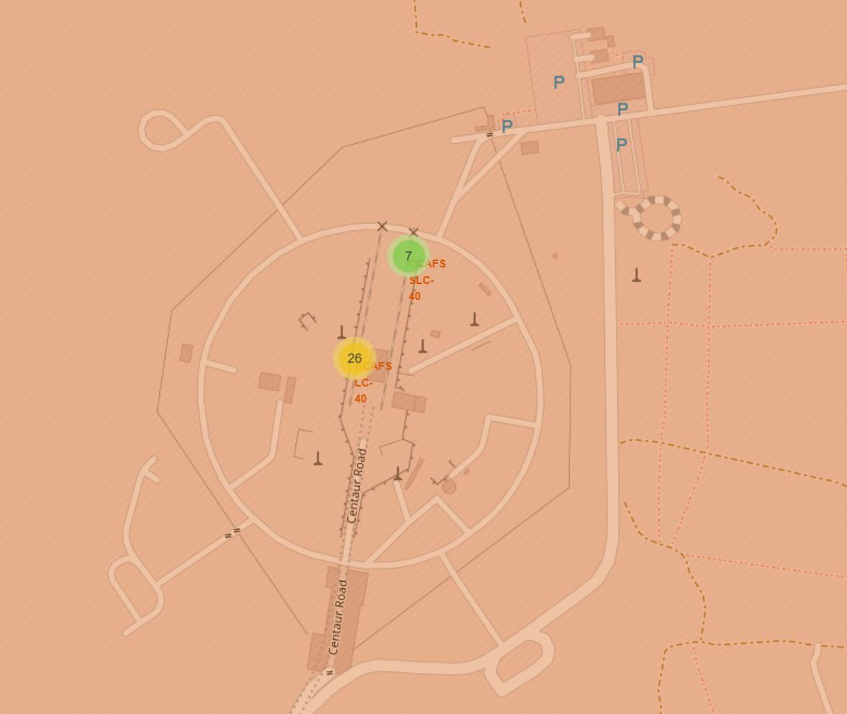
Successful Launches
This map shows successful and unsucesful launches for two of the Florida launches sites (CCAFS LC-40 and CCAFS SLC-40)

Slide 37
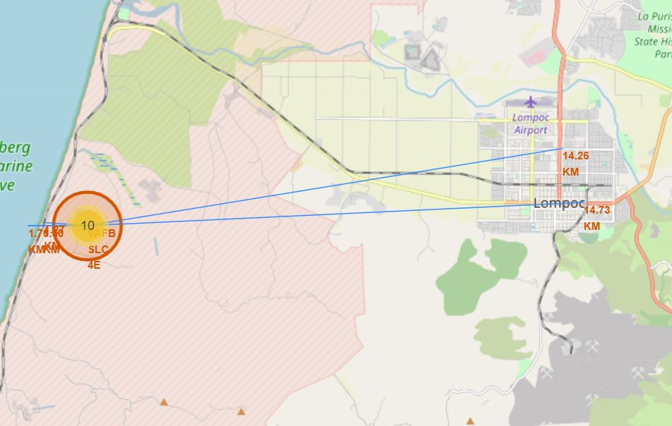
Launch Site Characteristics
This map shows that site VAFB SLC-4E is very close both to the coast and to a train line.
It is moderately close (under 15 kilometers) to a small city (Lompoc) and to a major highway.

Slide 38

Section 4

Slide 39
Successes by Launch Site
This piechart shows which launch sites had the greatest share of successful launches. Site KSC LC-39A has the most successful launches of any launch site.

Slide 40
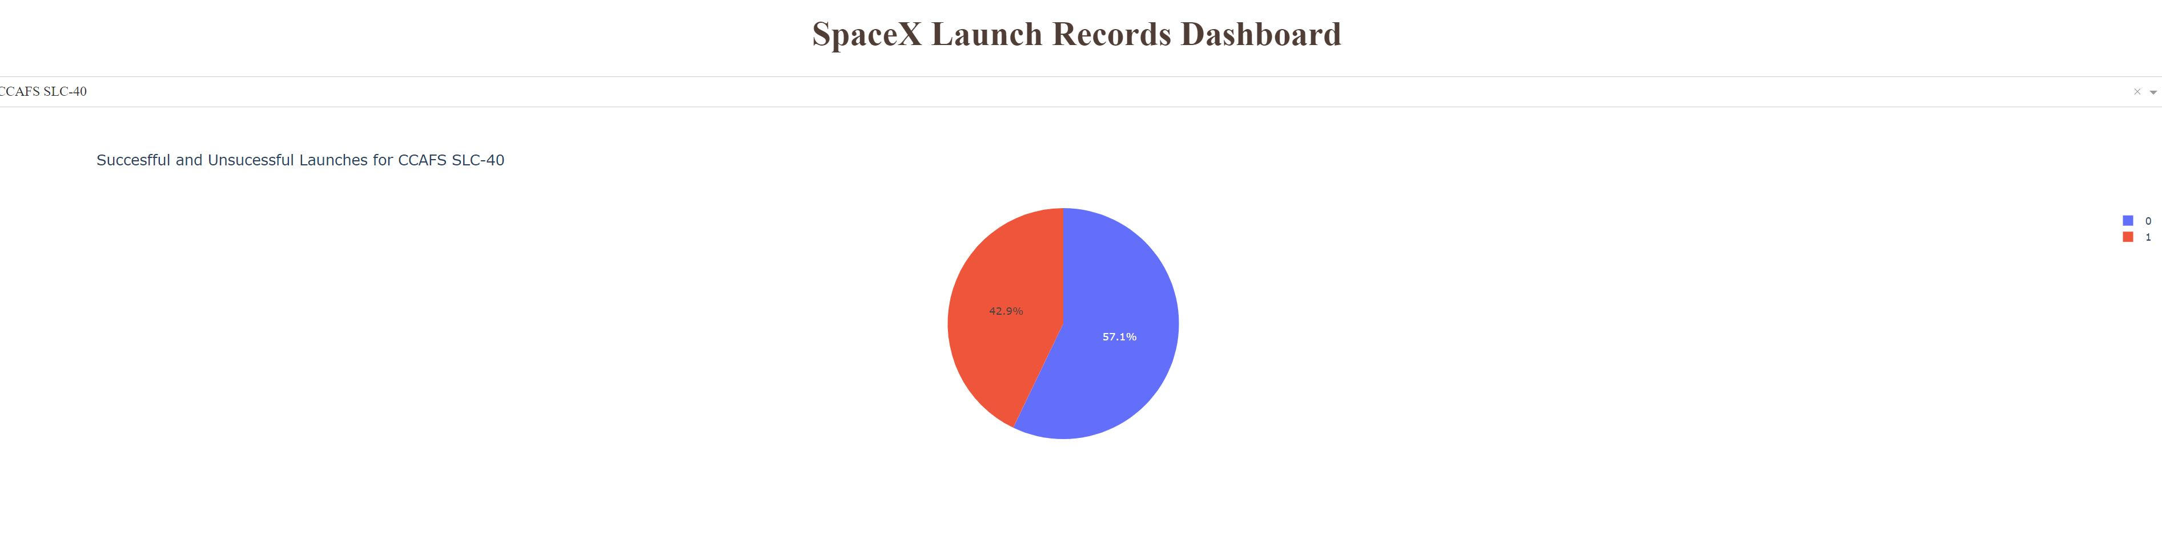
Launch site CCAFS SLC-4
This piechart shows that Site CCAFS SLC-40 had a more unsuccessful launches (57.1 %) than successful launches (42.9%).

Slide 41
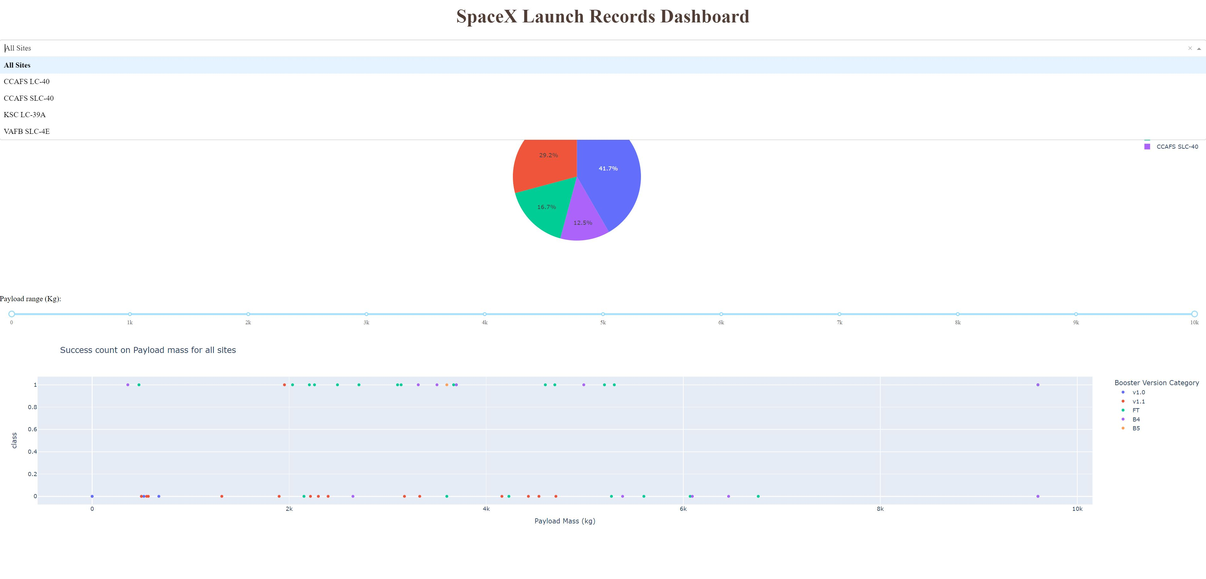
Booster success rates.
The bottom scatter plot shows the various successes and failures for different booster versions.

Slide 42

Section 5

Slide 43
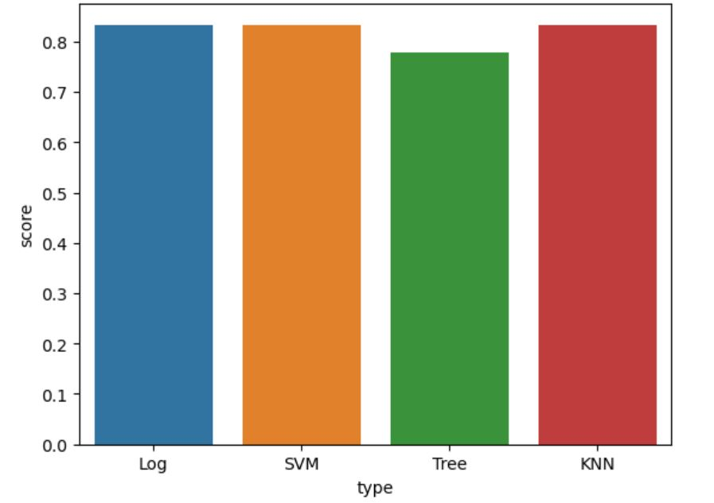
Classification Accuracy
Log, SVM, and KNN all performed similarly. Decision Tree was the worst performing model.

Slide 44
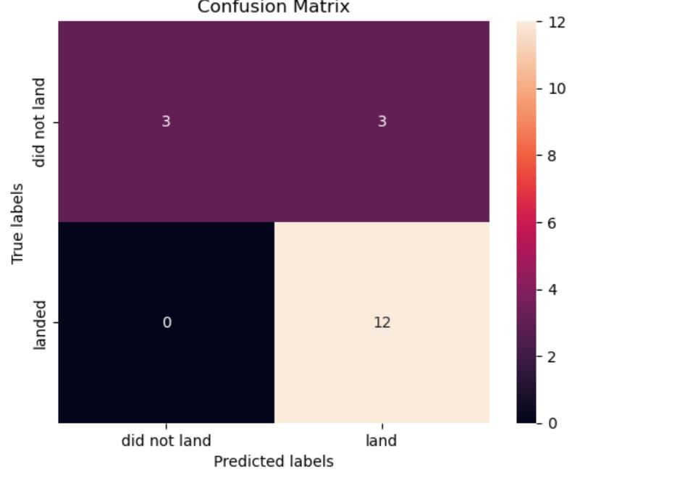
Confusion Matrix
This is the confusion matrix for the KNN classification model. It predicts launches that landed correctly. It incorrectly predicts some launches that did not land would land.

Slide 45
Conclusions
Spacex has had a number of launches over the past decade+
The success of these launches has improved over time
In this report, we have shown characteristics that correlate with successful landings
Hopefully by showing which characteristics contribute to successful launches, we can improve the proportion of successful launches even more.

Slide 46
Appendix
Python notebooks used for this analysis: https://github.com/gregsasso/Final-Project
Sample SQL query: %sql SELECT COUNT(*), landing_outcome FROM spacex GROUP BY landing_outcome ORDER BY COUNT(landing_outcome)
Sample python code:
df_year = df.groupby(df['Year'], as_index=False).mean()
#df_orbit
sns.lineplot(x="Year", y="Class", data=df_year)
plt.xlabel("Year", fontsize=10)
plt.ylabel("Avg Class", fontsize=10)
plt.show()

Slide 47


